Slide 1
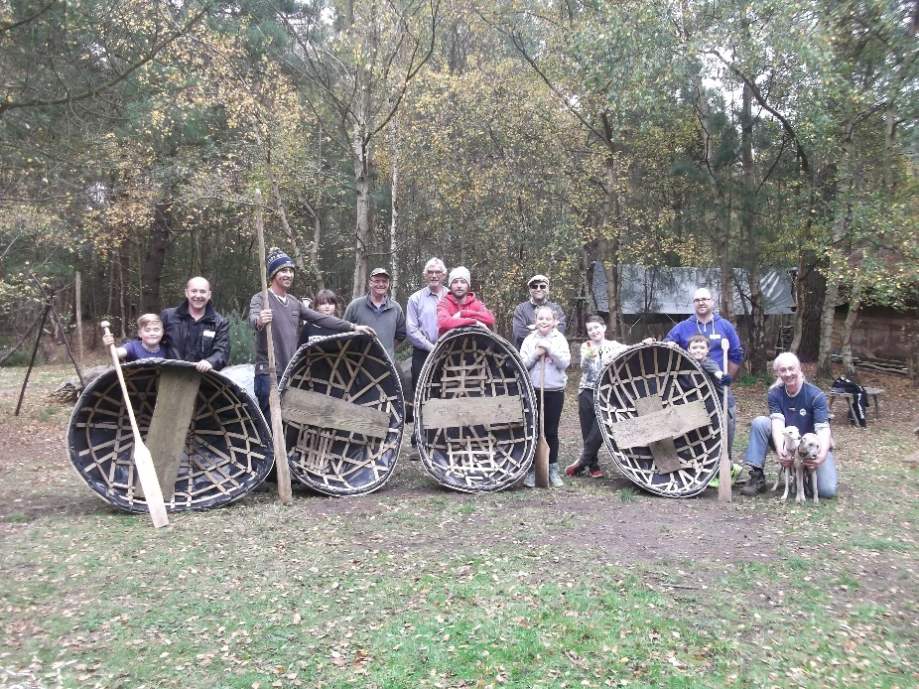
Coracle Building 2017 Kessingland Primary Academy

Slide 2
Introduction
We are very privileged, as a school, to have a strong working relationship with Duncan Allan and his team of volunteers at Hands on Heritage. Pupils of our school, have in previous years, been offered the chance to attend Hands on Heritage and coracle building.
When we contacted Duncan this year, we were overjoyed when he offered to provide 2 days coracle building for a group of our pupils, along with a supporting family member or nominated adult. This was offered with all volunteers, equipment, resources, lunch and refreshments provided by Hands on Heritage at no charge to our school or participants.
The following photographs and comments reflect the enjoyment and excitement experienced by all involved. Participants expressed that it was a valuable opportunity to spend time together, learn new skills and be able to have quality time away from everyday life and all it entails.
Without the support of Hands on Heritage we would not have been able to offer this experience to our pupils. Charity organisations such as Hands on Heritage are an important resource to schools in offering activities that support the holistic development of children and young adults.
A big thank you was expressed to Duncan and his team of volunteers on behalf of our school, and we are pleased to confirm Duncan has offered to extend this amazing experience to our school again in October 2018.
Kelly Haward & Lynda Hood

Slide 3
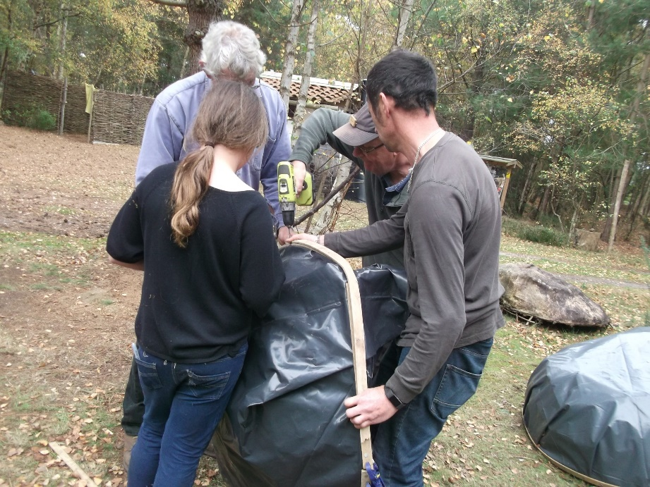
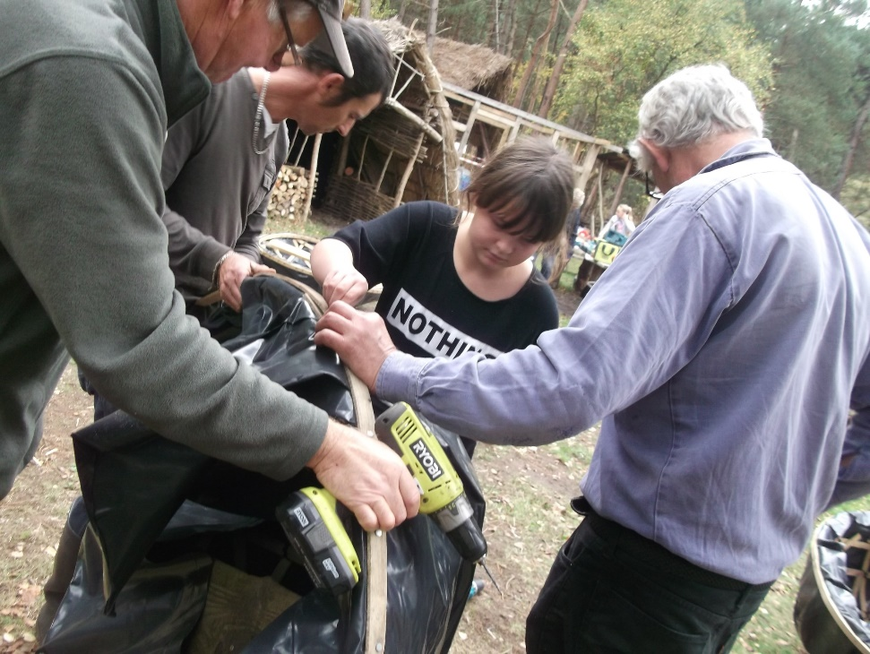
Learning new skills

Slide 4
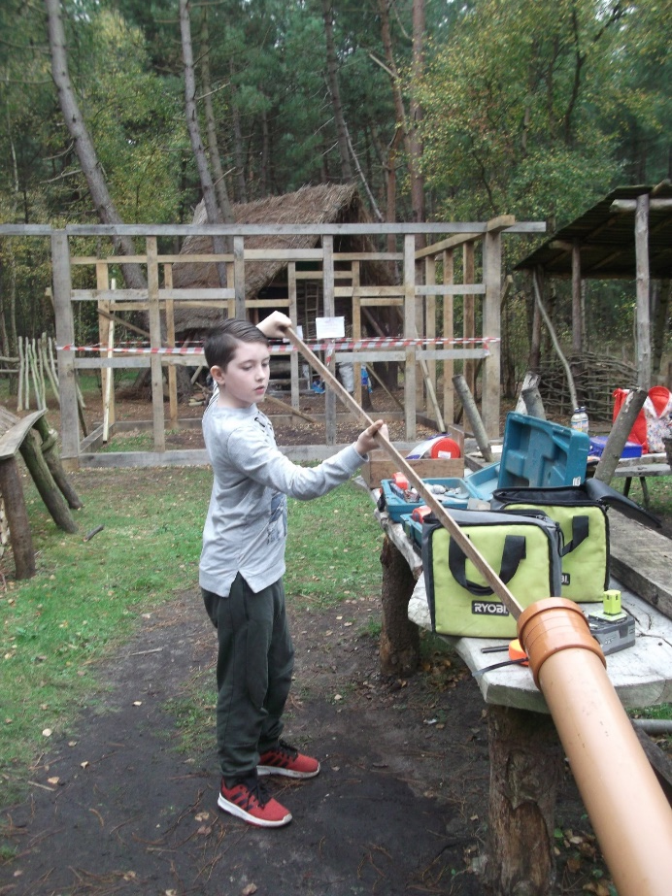
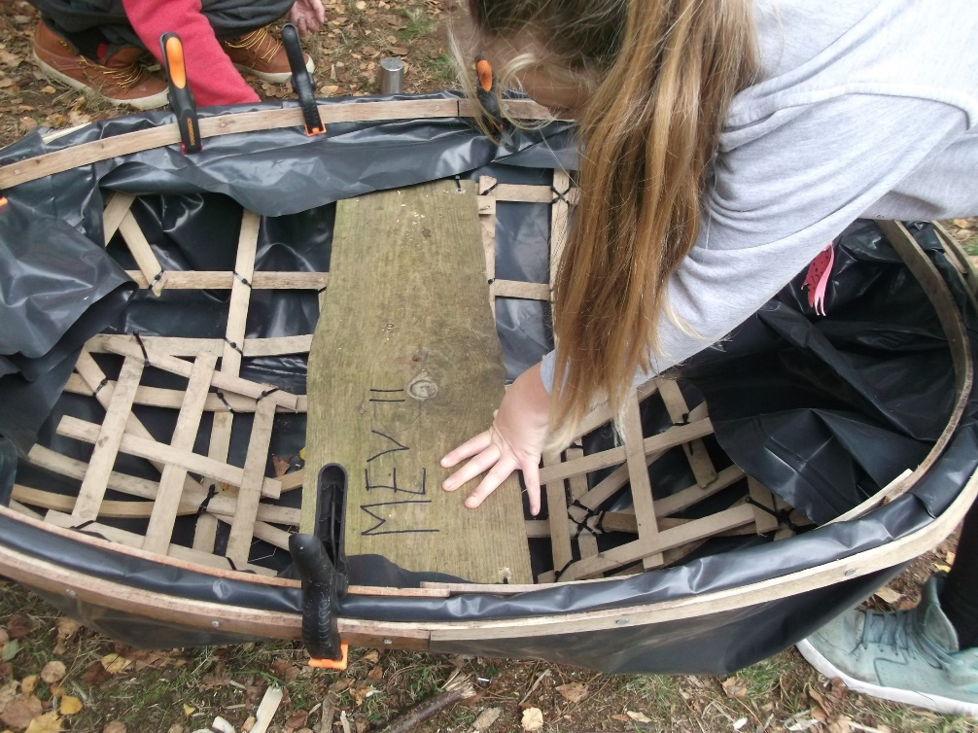
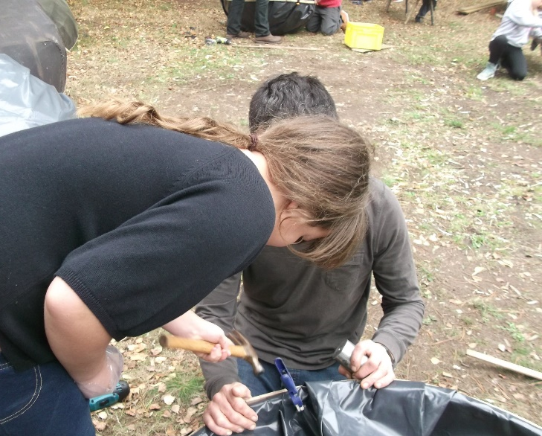
Building our coracles

Slide 5
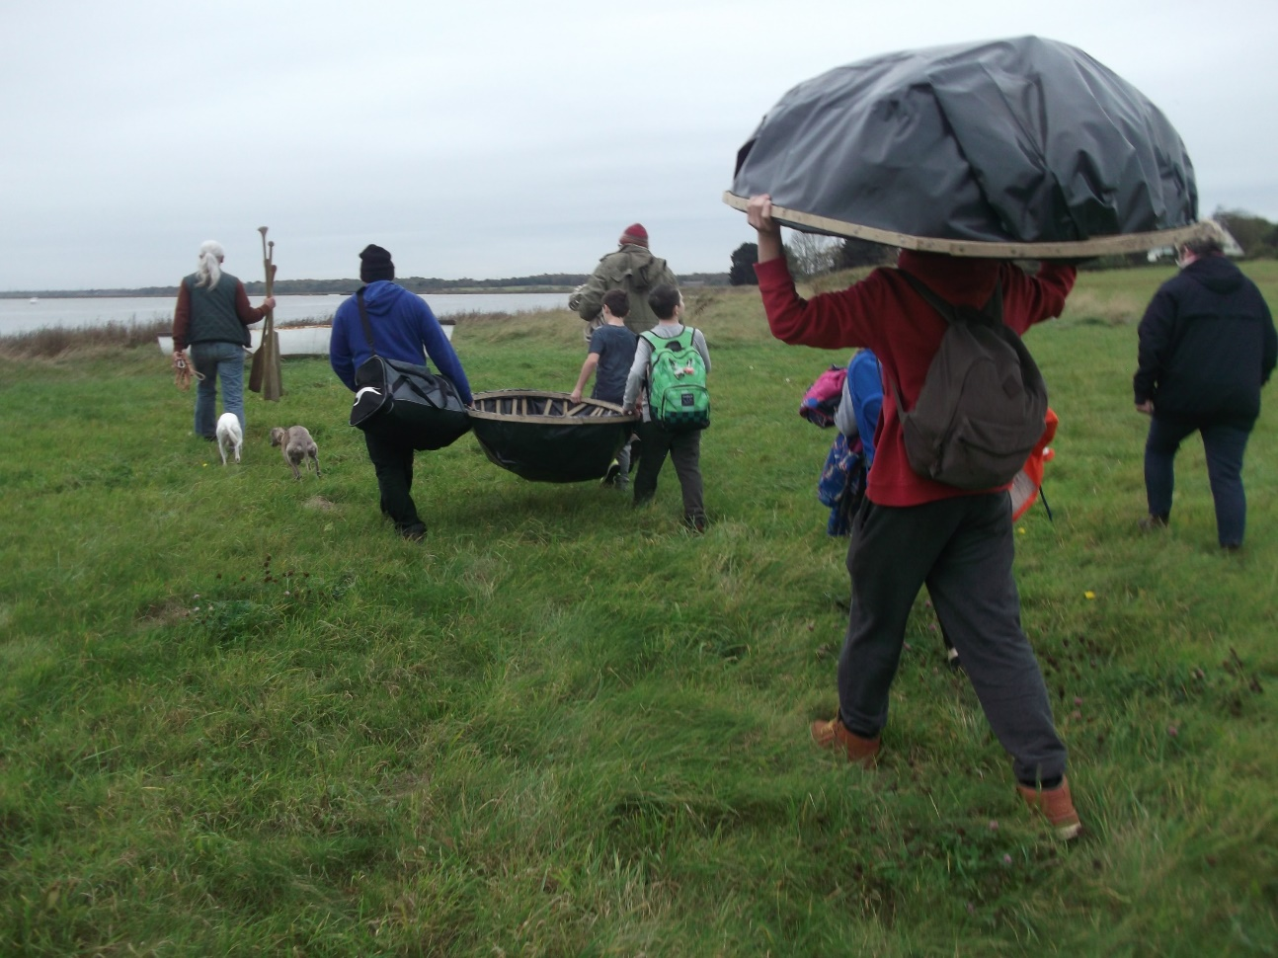
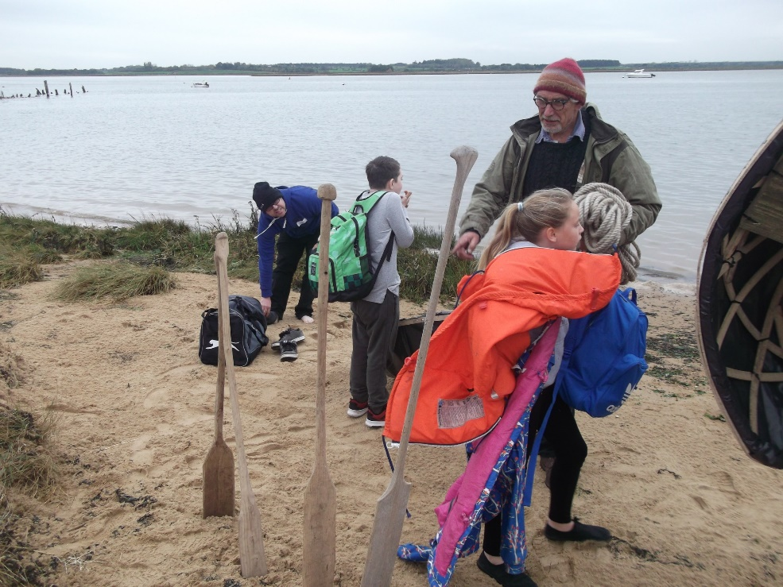
Will they float?

Slide 6
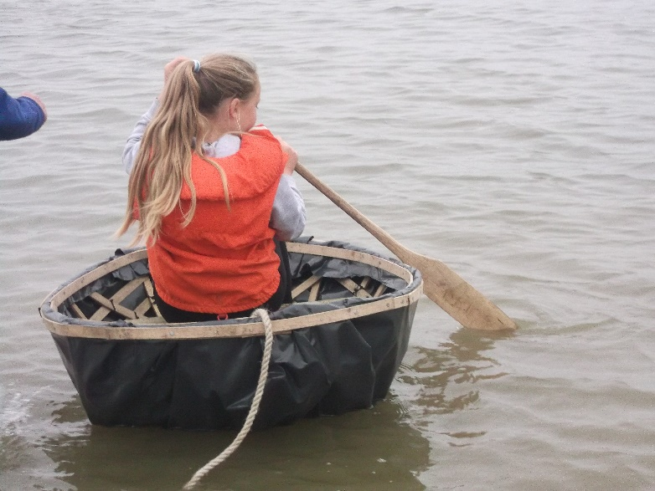
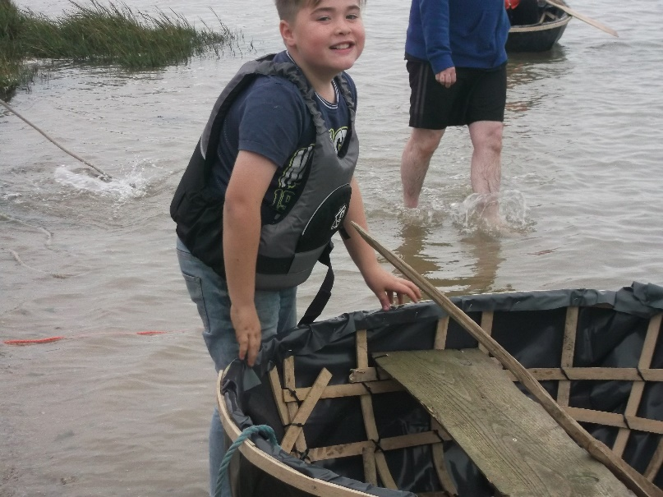
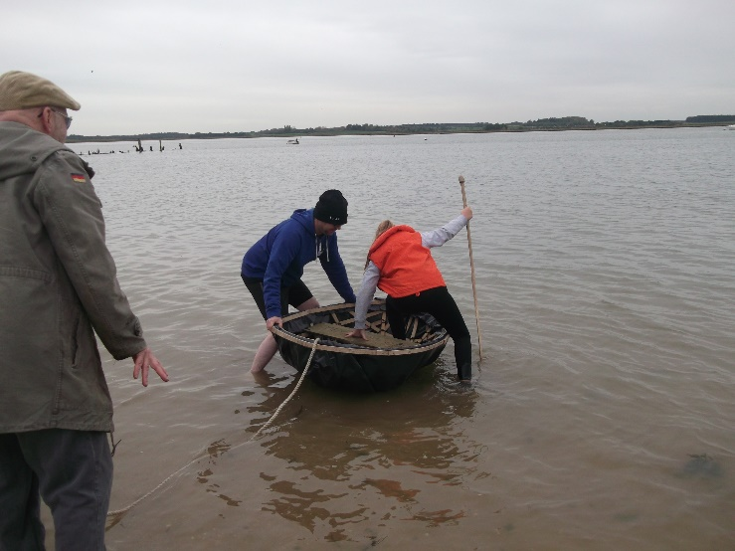
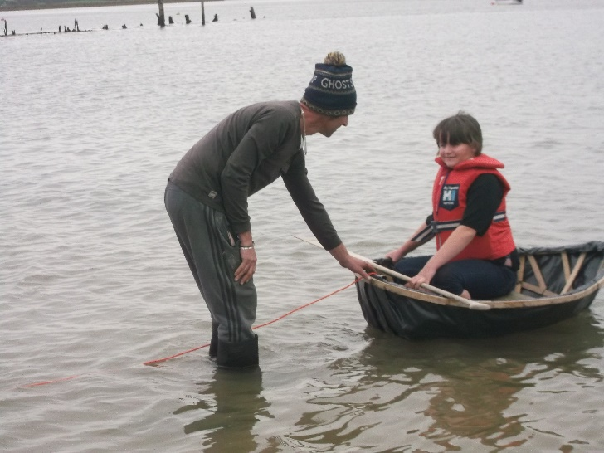
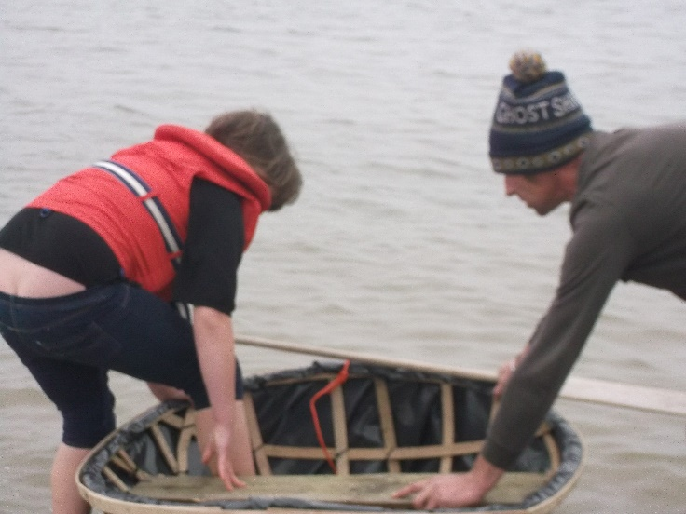
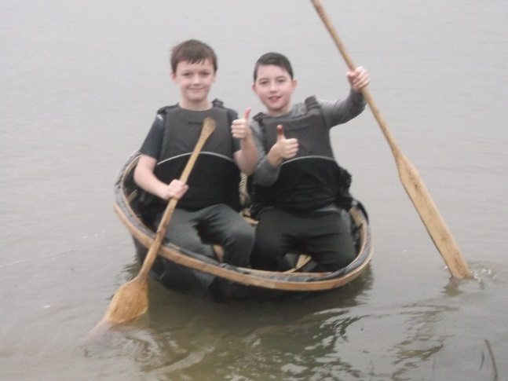
Yes!

Slide 7
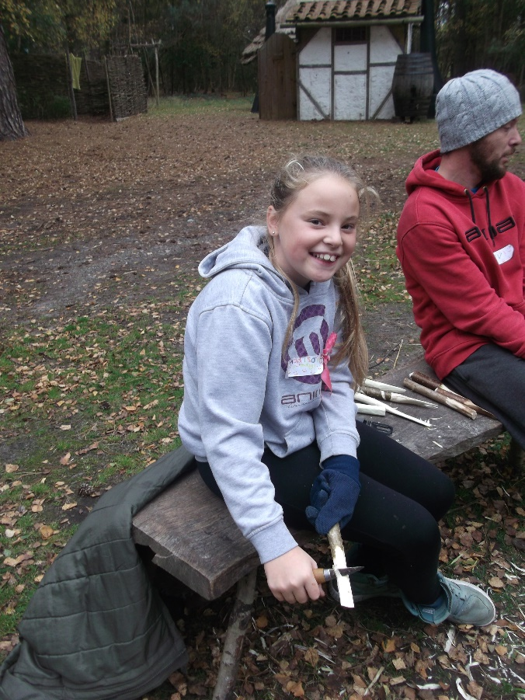
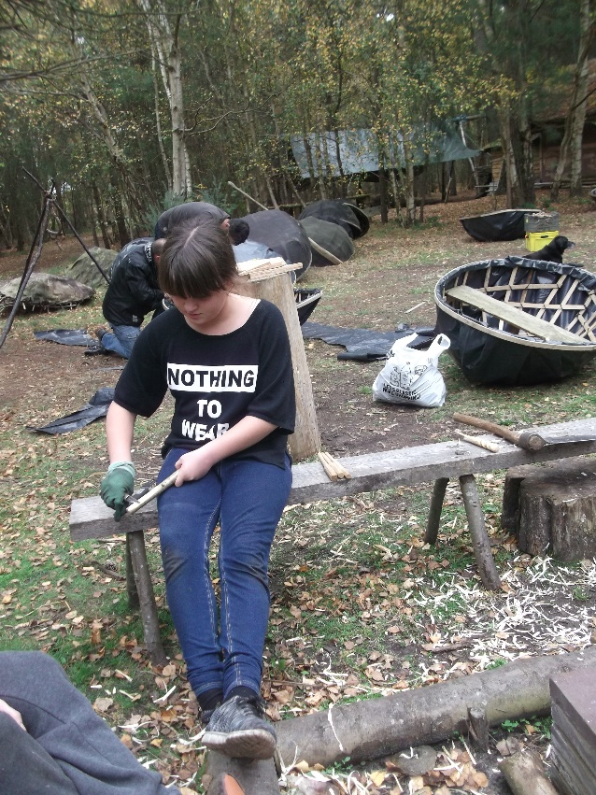
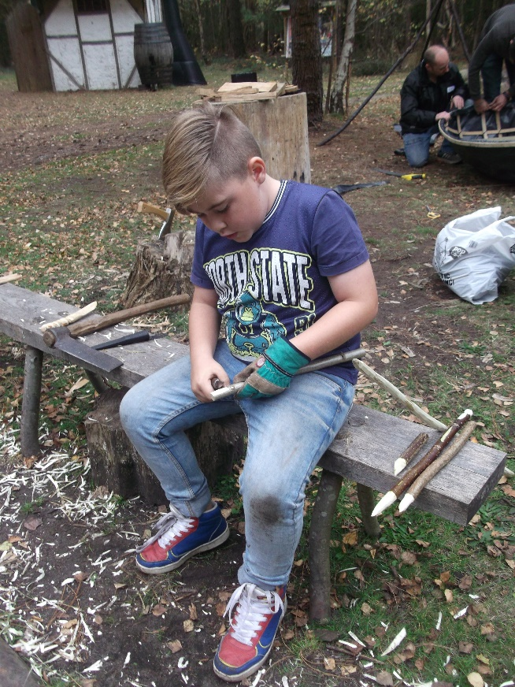
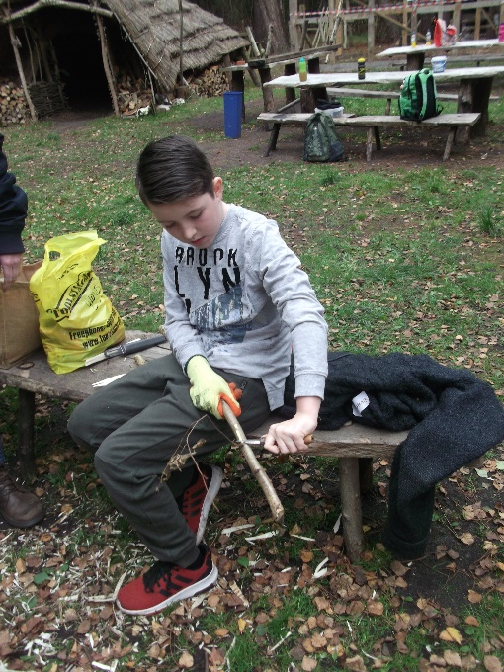
Learning Woodcraft skills

Slide 8
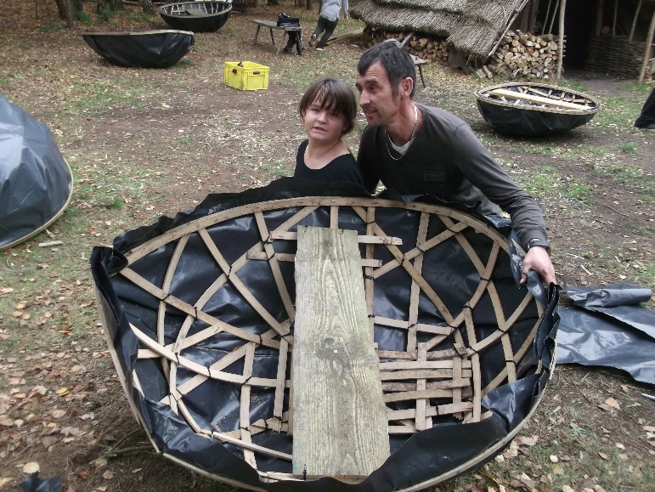
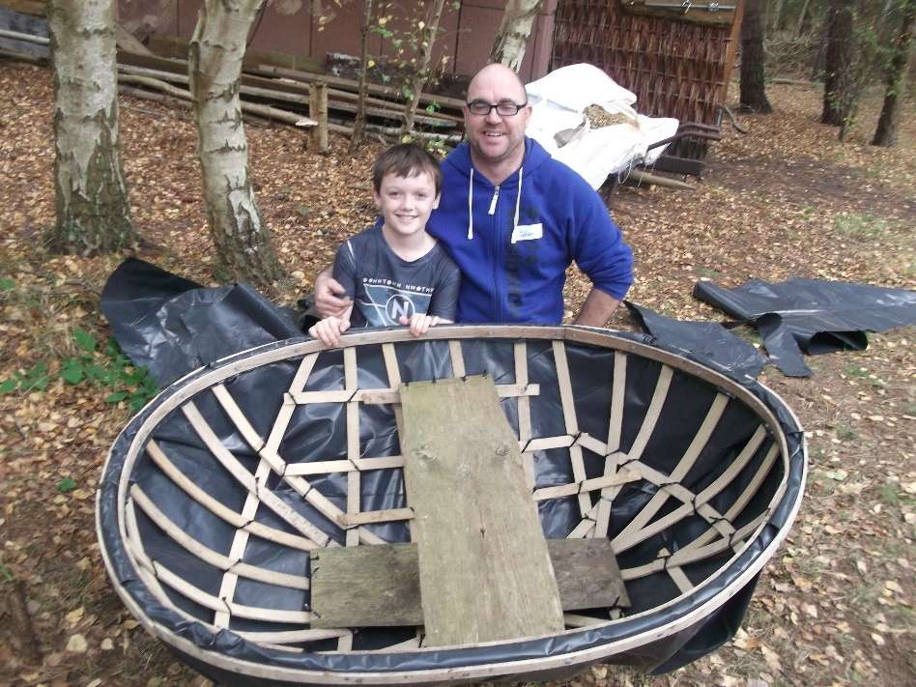
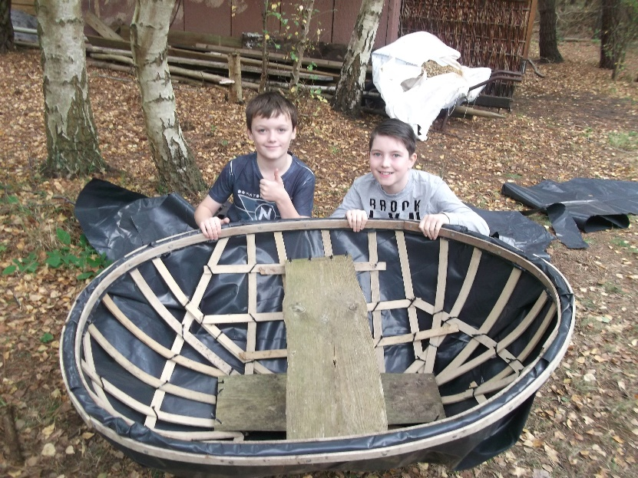
“Spending quality time with my daughter” “Spending time with my son, we’ve had so much fun” “Quality time being outside, no gadgets. Kids being kids” “Spending time with Dad and making the boat together and whittling” “I can’t believe we started with 13 sticks and this is what emerges” “I liked everything and using the hammers”

